Slide 1
Object Security for Contained RESTful Environments (OSCORE)
Kenny Vu, Kobe Leong, Moshe Goldstein, Shantanu Biswas

Slide 2
COSE and OSCORE
OSCORE builds on Concise Binary Object Representation (CBOR) Object Signing and Encryption (COSE)
COSE is tailored for constrained devices and uses binary encodings

Slide 3
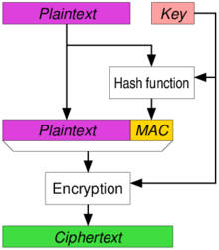
AEAD Algorithm
Is the bulk of encryption for COSE
Keeps the integrity and authentication of the message
The AD is the associated data which is the headers.
This helps constrained devices use less power and resources.

Slide 4
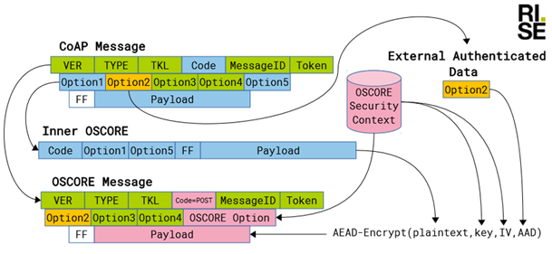

OSCORE Implementation
The Swedish Government Innovation Agency collaborated with one of the contributors of OSCORE from RISE (Research Institutes of Sweden)
Observations:
The mesh network in offices has a maximum transmission unit of 12 bytes.
The mesh nodes handled packet fragmentation robustly
OSCORE identified all the basic security threats.

Slide 5

OSCORE the next preferred protocol?
There is a good chance OSCORE will be the next preferred protocol.
Reasons being:
OSCORE protects each payload individually using pre-shared keys. Thus key negotiation and session management is not required anymore.
Unlike DTLS, OSCORE messages are not completely encrypted. The metadata is still left in clear text, saving computational resources, power, and bandwidth.
OSCORE identified all the basic security threats.

Slide 6

Security Context
OSCORE protection requires certain pieces of data
Each piece of data is extremely important in ensuring security
Some pieces of data must be agreed upon beforehand
Some pieces of data are derived from other pieces of data
There are 3 “main” pieces of data that have several pieces of data within them

Slide 7
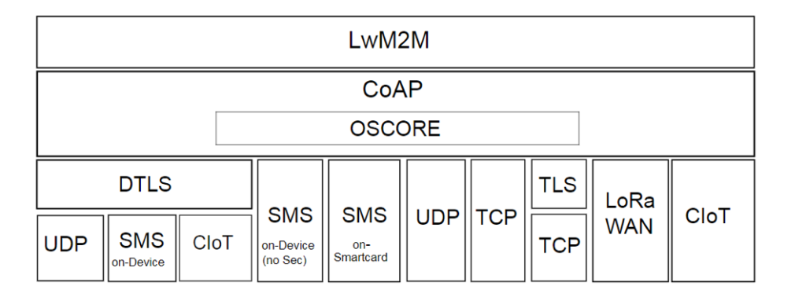
Definition of Security Context
Security Context is defined as the set of information elements that are required to carry out the cryptographic operations in OSCORE protection. It consists of three contexts:
Common Context
Sender Context
Recipient Context

Slide 8
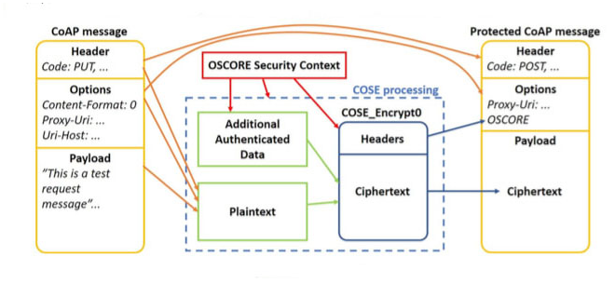
Definition of Security Context (Cont.)
Common Context consists of:
AEAD Algorithm
HKDF Algorithm
Master Secret
Master Salt
ID Context
Common IV
The Sender Context consists of:
Sender ID
Sender Key
Sender Sequence Number
The Receiver Context consists of:
Recipient ID
Recipient Key
Replay Window (Server Only)

Slide 9
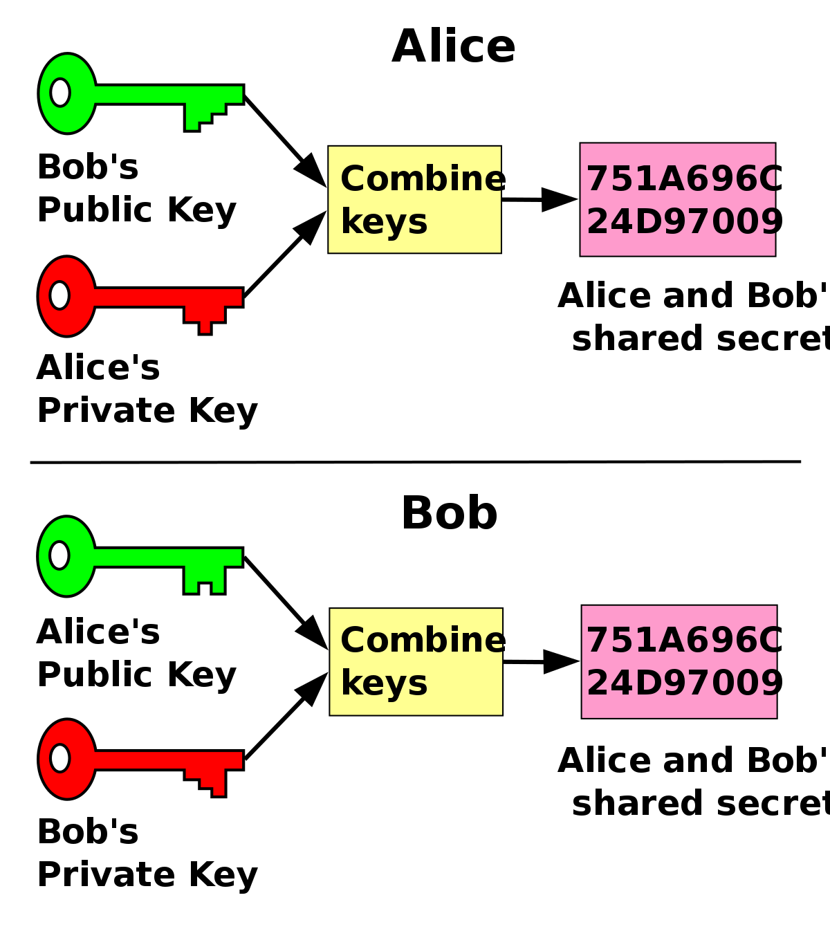
Security Context Establishments
Some pieces of data required by the OSCORE security protocol must be established beforehand
Another protocol, method, or algorithm can determine the required pre-established data:
Master Secret
Sender ID
Recipient ID

Slide 10

Security Context Requirements
Certain pieces of data must also be unique in order to maintain unique Sender Keys. These pieces of data are:
Master Secret
Master Salt
ID Context
Sender ID

Slide 11
CoAP Options
Class E
Max Age
Inner block
Outer block
Class I
Class U

Slide 12
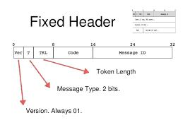
CoAP Header
Required to be read and modified during normal message exchange or when traversing a proxy
Not protected between endpoints
Header field code required to be in plaintext
Version number must be integrity protected
Other header fields not integrity protected or encrypted

Slide 13
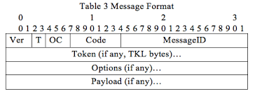
CoAP Payload
Encrypted and integrity protected through class E (inner message field)
Sending endpoint writes payload of original CoAP message into COSE object’s plaintext
Receiving endpoint verifies and decrypts COSE object
Payload of original CoAP message recreated

Slide 14
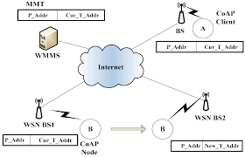
Signaling Messages
Transfer information about connection
Make up a third basic type of message in CoAP besides responses and requests
Message class 7 utilized

Slide 15
Sequence Number and Maximum Sequence Number
AEAD nonces not used more than once for each AED key
Partial IV’s used to encode sender sequence numbers, makes the key unique
When messages are processed at the same time, reading and increasing sender sequence number is atomic
Maximum sender sequence number is algorithm dependent and less than 2^40
If exceeded, endpoint can’t process any more messages and should get new security context

Slide 16
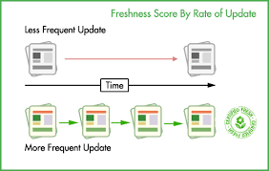
Freshness
OSCORE guarantees that message is not older than its security context
If stronger request freshness is required, OSCORE must be augmented with mechanisms providing freshness

Slide 17
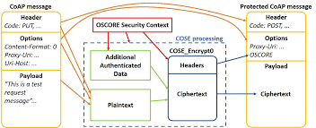
Protecting and Verifying Messages
OSCORE relies on the CoAP message processing implementation.
Once a CoAP message is requested, the client uses that to create as OSCORE request.
A client’s request is primarily protected through encrypting the COSE object using the sender’s key.
The requested message is formatted per its specifications.

Slide 18
Protecting and Verifying Messages(Continued)
The verification is then inverse to the protection.
The server will receive the OSCORE option and break it down into its individual components.
In particular, the Recipient Key in the ‘kid’ parameter to verify.
The server then recomposes the contents and decrypts the COSE object using the Recipient Key.
The server will also need to protect its response using a similar process.

Slide 19

Encryption
Concise Binary Object Representation is a data format designed for small code size and small message size.
OSCORE uses it for constrained services.
Common Parameters:
Kty: identifies family of keys
Alg: restricts the algorithm that is used with the key
Kid: gives identifier for the key
Key_ops: restricts set of operations a key is used for
Base IV: Carries the base portion of IV

Slide 20
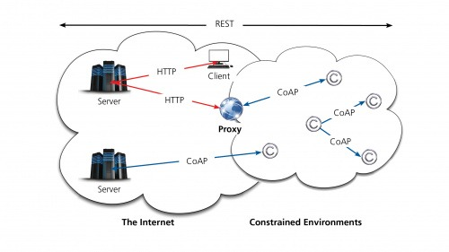
Mappings
CoAP-to-HTTP mapping places the value of CoAP in base64url encoding without padding.
It adds in AA if the OSCORE option is empty. The CoAP Content-Type is set to ‘application/oscore’.
HTTP-to-CoAP mapping needs to specify the behavior of the proxy.
It has the value HTTP header field decoded from base64url without padding.

Slide 21
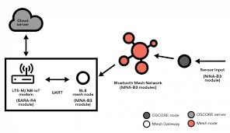
OSCore Implementation
Data is sent from an internet of things sensor to the cloud.
First, the data is encrypted with OSCORE using cryptographic information pre-shared during setup.
Encrypted messages can be as small as 11 bytes which is suitable for restrained devices.
The CoAP message is then sent in a standard Bluetooth Mesh status message.
During transmission, the data is stopped by a gateway device.

Slide 22
OSCore Implementation(Continued)
The CoAP message including the OSCORE encrypted data is repacked into a UDP message and sent to the cloud.
Once the data arrives at the cloud server, it is decrypted using the cryptographic information pre-shared with the OSCORE sensor

